Slide 1
Platforms: Lecture 10: External Buses

Slide 2
IDE/ATA
Nominally called the IDE (Integrated Drive Electronics) bus; how ever it's more correctly known as the ATA (Advanced Technology Attachment) specification [ATA Bus].
Used in PCs as a hard-drive or peripheral bus to interconnect the PC mother board and a hard drive.
The IDE bus is a Parallel bus: 16 bits at once
With the introduction of the SATA specification, Parallel ATA [IDE] is now being called PATA
The specification has been upgraded a number of times
Each new version of the standard produced an increase in bus speed.
The maximum IDE bus speed is 133MBytes/sec [133MBps].

Slide 3

IDE/ATA motherboard connector
On older machines usually two connectors IDE1 and IDE2
Each can control two devices: typically HDD, DVD or CD drives

Slide 4
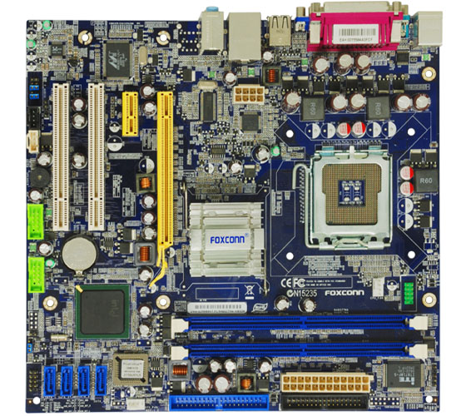
IDE/ATA motherboard connector

Slide 5
IDE/ATA examples
ATA-2 (EIDE, or Fast ATA), [Obsolete] 16.6MBytes/sec, 8 or 16 bit data width, 40 pin data ribbon cable/connector
ATA-7 Ultra-ATA/133, 133MBytes/sec,16 bit data width/40 pin data connector/80 pin cable,
additional 40 new pins are Ground
ATAPI (ATA Packet Interface) is the CD-ROM side of the interface. Same connector as ATA, +1 extra for analog and +1 for digital audio

Slide 6
IDE/ATA Interface
ATA-# interface for disk drives; defines the Physical layer, Electrical layer and Signalling protocol
The hard drive, computer, and software determine the mode used: Programmed Input/Output (PIO) or Direct Memory Access (DMA).
Addressing on the bus is defined by the HDD: CHS (Cylinder, Head, Sector)

Slide 7
SATA
SATA sends a bit at a time
(cf. PATA sends 16 bits at once)
Uses a 4 conductor cable with two differential pairs [Tx/Rx], plus an additional three ground pins and a separate power pin.
Data runs at 150MBps [1.5GHz] using 8B/10B encoding and 250mV signal swings

Slide 8
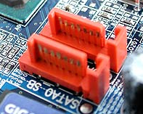
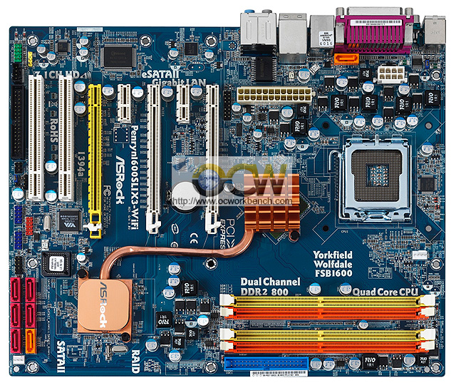
SATA Motherboard Controller
Here six SATA II connectors

Slide 9
8B/10B Encoding and SATA versions
each 8 bit data byte is translated into a 10 bit character in order to equalize the numbers of 1's and 0's sent
this achieve DC-balance and bounded disparity, and yet provide enough state changes to allow reasonable clock recovery.
the encoded signal also contains an embedded clock.
SATA-1 Data runs at 1.5Gbps using 8B/10B encoding and 250mV signal swings
Latest SATA 3.2 runs at 16Gbps transfer rate

Slide 10
SATA Bus Protocol Frame
Used between host and device
SO: . Start-of-frame
FIS: Frame Information Structure
CRC: Cyclic Redundancy Code
SATA uses a 32bit CRC (calculated over the contents of the FIS)
EOF: End-of-Frame

Slide 11
PCI
Peripheral Component Interface 'PCI' Bus
originally developed as a local bus expansion for the PC (ISA) bus
PCI(original): 32 bit bus @ 33MHz (133MB/s)
PCI-X: 64 bit bus@ 133MHz (1064MB/s)
i.e. transferring either 32 or 64 bits of parallel data on each clock ‘tick’

Slide 12
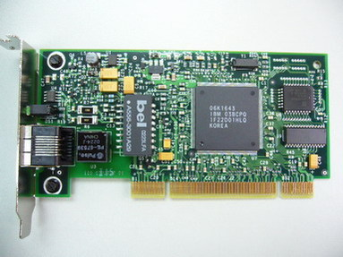
PCI Expansion Card
Here as a network card
PCI cards also for
modem, graphics card (older computers), scanner, sound card, game controller

Slide 13
PCI Motherboard Connectors
Here are two (white) PCI connectors

Slide 14
PCI Bus
(64bit) PCI bus is made up of the following (major) signals:
Address/Data Bus: 64bit Address; 64bit Data, (Time Multiplexed)
System Bus: 2 bits; (Clock/Reset)
Interface Control Bus: 7bits; (Ready, Acknowledge, Stop).
Parity Bus: 2 bits (1 for the 32 LSBs and 1 for the 32 MSB bits)
Errors Bus: 2 bits, (1 for Parity and 1 for System)
Command/Byte Enable: 8 bits (0-3@32bit, and 4-7@ 64bit Bus)
64MHz Control: 6 bits; (2-Enable/Running), (2-Present), (2-Ack/Req)
Cache: 2 Bits, Interrupt bus: 4 bits, JTAG Bus: 5 bits
Power: +5, +3.3, +12, -12v, GND

Slide 15
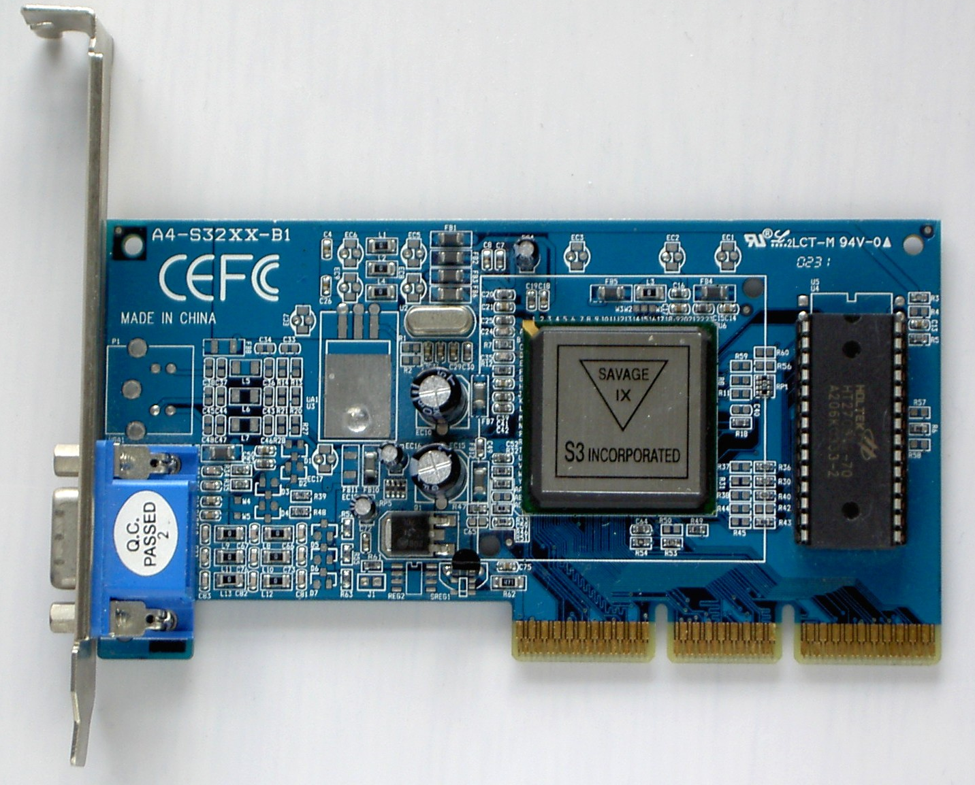
AGP
The Accelerated Graphics Port
a Video Local bus
derived from the PCI bus but with 20 additional signals
The PCI-Express card bus has replaced the AGP bus
Right an AGP expansion card

Slide 16
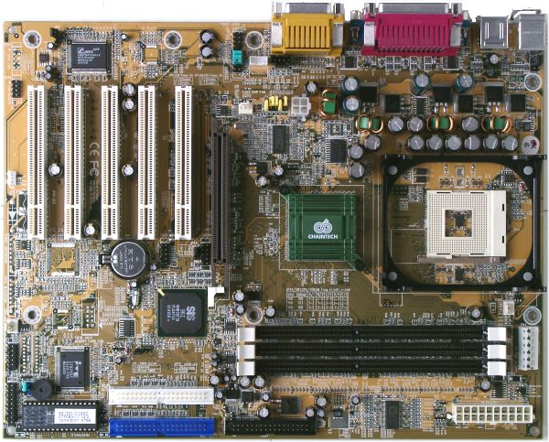
AGP Motherboard connector
Dark brown AGP - now only seen in older computers
The specification increased from 1x to 8x speeds
AGP 3.0 8x: Rate = 2.133GB/s

Slide 17
PCI Express (PCIe)
PCI Express specification :
a point to point serial interface over copper wire or optical fibre.
The link is two low-voltage differential pairs of wires, at 2.5Gb/s in each direction [one transmit, and one receive pair].
Overall rate of 16 Gb/s
PCI Express uses 8B/10B encoding
each 8 bit byte is translated into a 10 bit character in order to equalize the numbers of 1's and 0's sent, and the encoded signal contains an embedded clock.

Slide 18
PCIe
On a motherboard
x1 PCIe slot will support a bandwidth of 5Gbps (used as a usual expansion card slot)
x16 PCIe slot will support 80Gbps (used as video card expansion slot)
PCIe connectors & busses are NOT compatible with PCI
At the software level they are compatible. Legacy applications and OS can use PCIe as though PCI, without using it’s newer features.

Slide 19
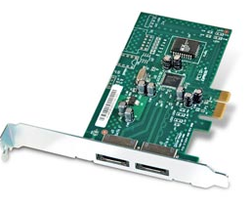
PCIe Card
Here a x1 PCIe (driving two SATA2 (3Gb/s) port) LaCie

Slide 20
PCIe motherboard connectors
One x1 PCIe and one x16 PCIe

Slide 21
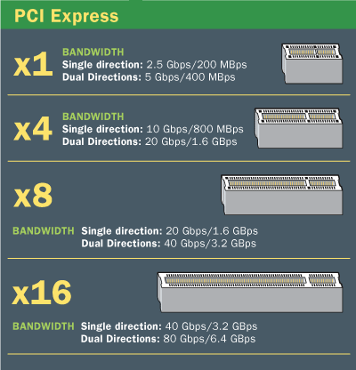
PCIe Types

Slide 22
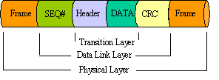
PCIe Protocol
1-byte Start-of-Frame
2-byte Sequence Number
16 or 20-byte Header
0 to 4096-byte Data field (size depending on data !)
4-byte ECRC field, & 4-byte LCRC
End-to-end CRC; local CRC
1-byte End-of Frame.
At best: 4096 bits of data in a total frame of 4124 bits
i.e. 192 bits of non-data are always transmitted

Slide 23
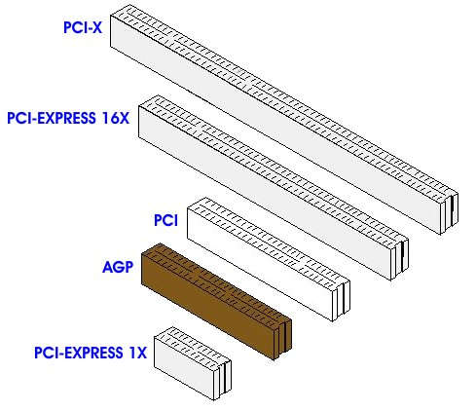
Bus Connector Comparisons

Slide 24
Firewire Bus: IEEE 1394
High performance serial bus
Devices on the bus are Hot-Swappable.
supports up to 63 devices at a maximum cable distance between devices of 4.5 meters.
The maximum devices on the bus is 16 allowing a total maximum cable distance of 72 meters.
The digital interface supports either asynchronous and isochronous data transfers.
Addressing is used to a particular device on the bus. Each device determines its own address.

Slide 25
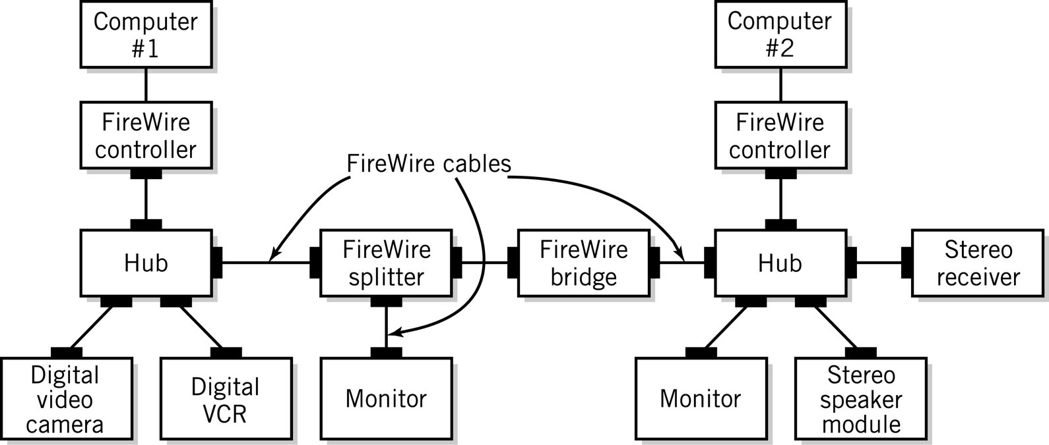
Firewire Bus: IEEE 1394
Network-like characteristics
Device controllers independent

Slide 26
Firewire Data Speeds
UTP cable over 100m distance
Over Fibre cable over CAT5 UTP cable up to 100Mbps [1394a] Half-duplex Manchester encoding
over CAT5 cable up to 800Mbps [1394b]. Full duplex and 8B/10B encoding
Over CAT5(but better Cat5e or 6) cable up to1600Mbps [1394c] Gigabit Ethernet or 1000Base-T
at 1Gb/s: (Distance depends on the fibre):
plastic MM fibre – 550m
SM fibre – up 10km
SM fibre (@1550nm) - ~ 70km

Slide 27
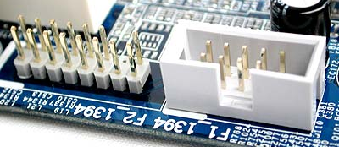
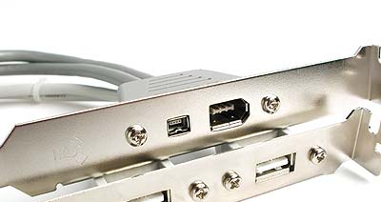
Firewire Connector
Different types of 1394 connectors, usually mounted on a bracket, which is then cable connected to a header on the motherboard
IEEE1394 headers on motherboard
Two types of IEEE1394 output connectors
(mini DV + 6-pin connector )
on bracket

Slide 28
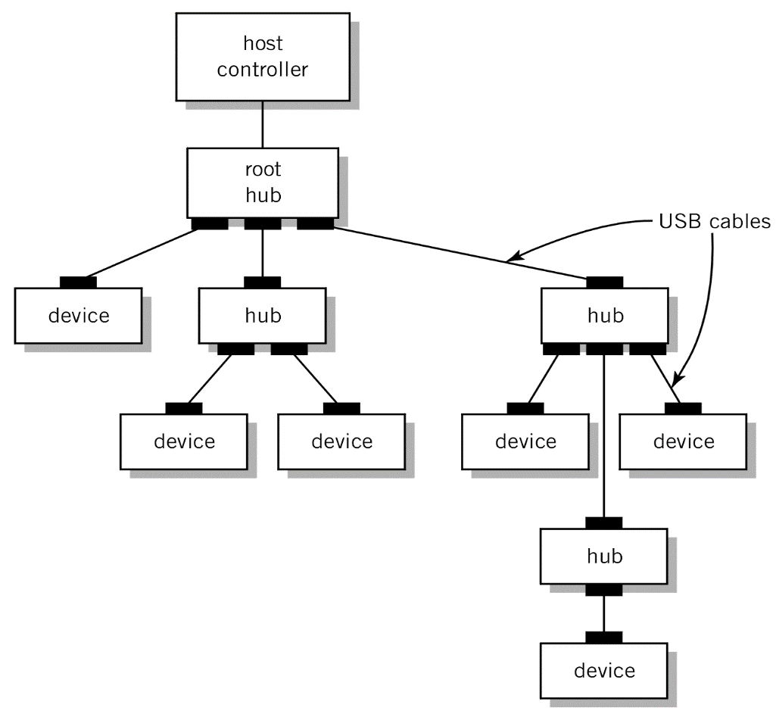
USB
USB defines 2 types of hardware: Hub and Device.
Up to 127 devices may be connected together in a tiered Star topology - the limiting factor being 7 address bits.
The physical wire segments are point-to-point between a Host, Hub, or Device.
The system may only have one Host, which connects to a Hub (or to a single device).
A USB Hub may connect to another Hub or to a USB device – Hubs provide multiple connection points for devices.
Root
Hub
Hub
Hub
Hub

Slide 29
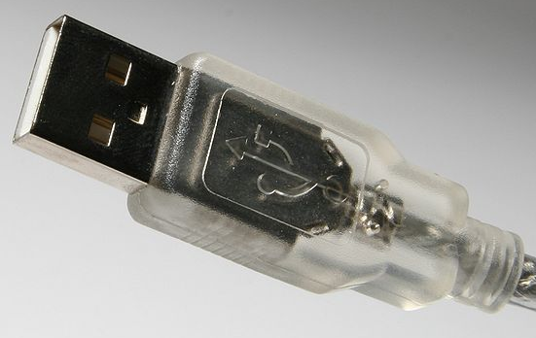
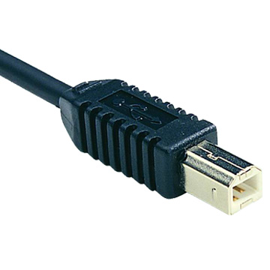
USB
USB cable connector/plug type A
USB cable connector/plug type B

Slide 30
USB
A USB port supplies 5V
Unit load defined as 100mA USB 2.0 (150mA USB 3.0).
A maximum of 5 unit loads can be drawn from a port in USB 2.0 ( 6 in USB 3.0)
2 types of device: low-power and high-power.
Low-power devices draw at most 1 unit load (100mA)
High-power devices draw (up to) the maximum number of unit loads supported by the standard (500mA)
All devices default as low-power but the device's software may request high-power as long as the power is available on the providing bus.
Non-Standard devices
External hard drives: use one cable/port for data and power + one cable/port for power only
Non-communicating devices: lights, vacuum cleaners, battery chargers: take power only

Slide 31
USB / Firewire similarities
Both serial, multipoint bus specifications
Add/remove devices w/o powering down
Packet protocol for isochronous data transfer
Isochronous: delivery at regular time intervals
Guarantee specified throughput

Slide 32
USB / Firewire differences
USB: slow to medium speed data transfer applications, i.e., storage devices
12 Mbits/sec
USB-2: high-speed data transfer
480Mbits/sec
USB-3 (SuperSpeed USB )
4.8Gbits/sec
FireWire: high-speed data transfer, i.e., full motion video with sound
400 Mbits/sec to 3.2 Gbits/sec

Slide 33
USB / Firewire differences
USB 1.0 and 2.0 use a "speak-when-spoken-to" protocol; peripherals cannot communicate with the host unless the host specifically requests communication. (USB 3.0 allows for device-initiated communications towards the host ).
A FireWire device can communicate with any other node at any time, subject to network conditions.
A USB network relies on a single host at the top of the tree to control the network.
In a FireWire network, any capable node can control the network.
USB runs with a 5V power line, while Firewire can supply up to 30V.

Slide 34
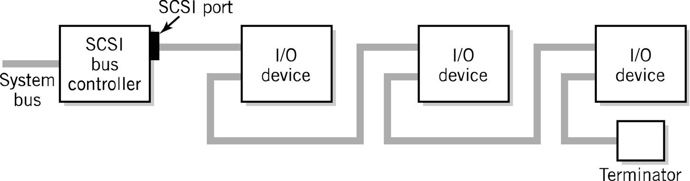
SCSI
Small Computer System Interface
Multiple variations to the original ANSI standard
Really an I/O bus rather than simple interface
Supports multiple devices from a single SCSI port

Slide 35
And more connectors
Mini-USB for smartphones, ereaders etc.
Various Lightning and earlier connectors for iPads etc

